Slide 1

Optimizing Pathfinding Algorithms for Real-World Applications: A Comparative Study
NAME : Deekshitha Chowdary Kalluri
COURSE: CIS 730 - Artificial Intelligence
INSTRUCTER : Dr. William Hsu
DATE: 5/14/2025

Slide 2
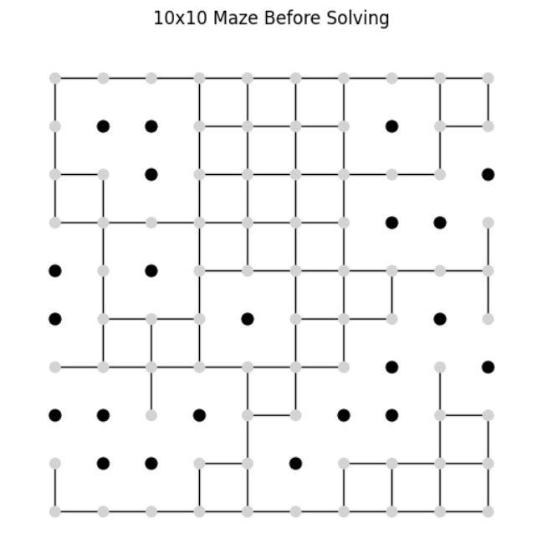
INTRODUCTION
What is Pathfinding?
Pathfinding is the process of determining the shortest or most efficient route between two points.
It plays a vital role in robotics, autonomous navigation, video games, and logistics.
Why Does It Matter?
Efficient pathfinding reduces computational time and converses system resources.
Inaccurate or slow pathfinding can result in system delays or operational failures.
Project Goal
Evaluate and compare five popular pathfinding algorithms within a uniform test environment.
Identify their performance trade-offs and recommend scenarios where each platforms best.

Slide 3
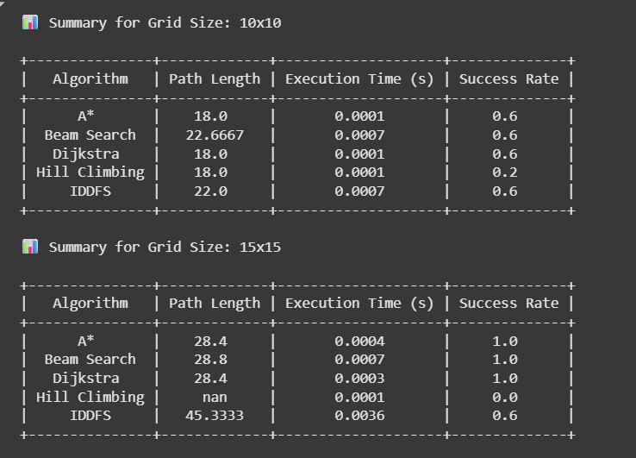
STATEMENT
Objective of the Project
Implement and evaluate five pathfinding algorithms: A* (A-Star), Dijkstra’s, IDDFS (Iterative Deepening Depth-First Search), Beam Search, and Hill Climbing.
Test these algorithms on randomly generated 2D grid mazes with obstacles.
Key Questions
How efficient is each algorithm in terms of speed?
Do they consistently find the shortest path?
How robust are they across different grid layouts?
Performance Metrics
Execution Time: Total runtime in seconds.
Path Length: Number of steps in the path found.

Slide 4
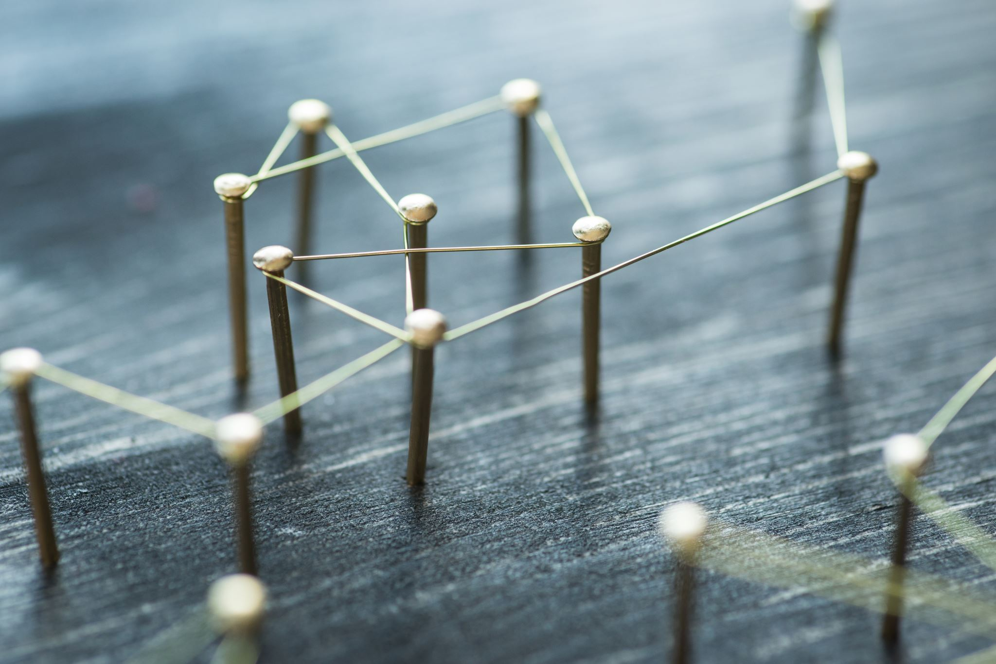
ALGORITHMS
A*
Uses both path cost (g) and estimated distance (h) to goal.
Optimal and efficient when the heuristic is admissible (does not overestimate).
Dijkstra’s Algorithm
Similar to A* but uses no heuristic (h = 0).
Guarantees shortest paths but explores more nodes than A*.
IDDFS
Combines low memory usage of DFS with the completeness of BFS.
Repeatedly revisits nodes, which increases execution time.
Beam Search
Expands only the best k nodes at each depth level.
Faster, but not guaranteed to find a path; may miss optimal solutions.
Hill Climbing
Greedy approach: always chooses the neighbor closest to the goal.
Very fast, but prone to getting stuck in local minima.

Slide 5
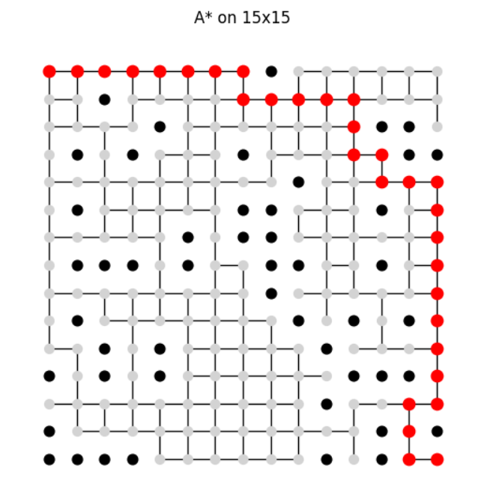
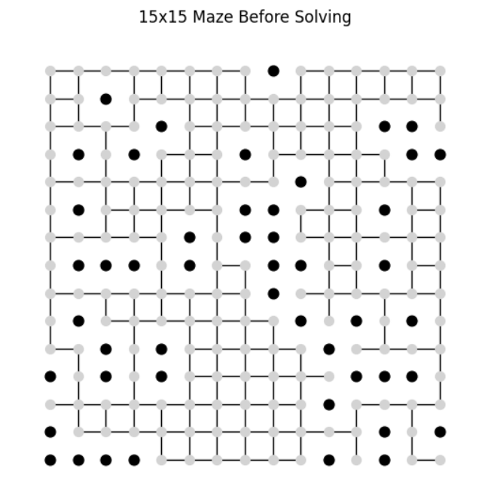
METHODOLOGY
Environment Setup
Tested on 10x10 and 15x15 grids, each with 20% of cells randomly blocked as obstacles.
Start: top-left corner (0,0)
Goal: bottom-right corner (size-1, size-1)
Manhattan distance used as the heuristic.
Implementation
Python 3 in Google Colab.
Used NetworkX for graph structure.
Algorithms modularized for easy testing.
Each algorithm was run 5 times per grid size (N=5) for statistical comparison.
Experiment Design
All algorithms are deterministic; variation comes from random maze generation.

Slide 6
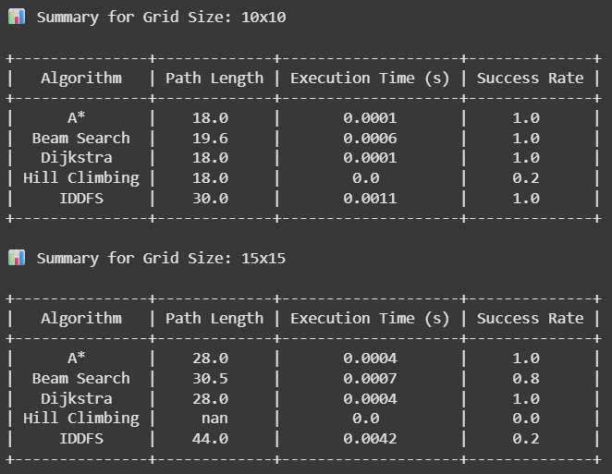
METRICS
Path Length
Measures how many steps the agent takes to reach the goal.
Lower values indicate more direct, efficient routes.
Execution Time
Time taken by the algorithm to compute a path.
Measured using Python’s time.perf_counter() for high precision.
Success Rate
Indicates whether a valid path was found.
Especially important for incomplete or greedy algorithms like Hill Climbing.

Slide 7
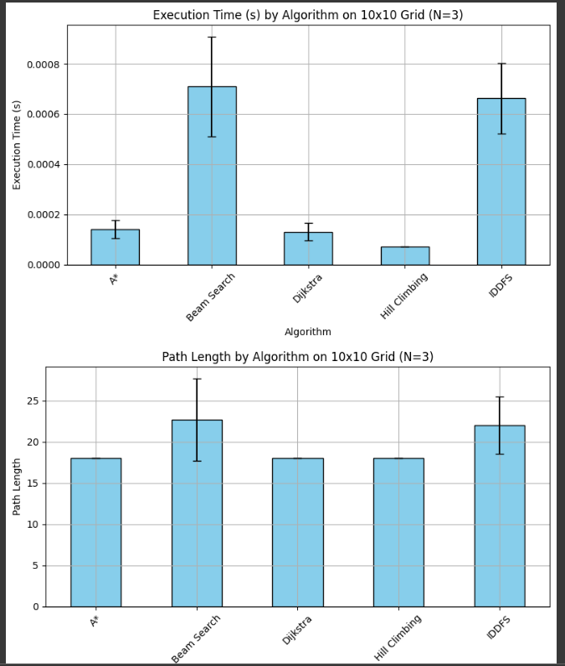
EXECUTION TIME & PATH LENGTH (10x10)
Mean execution time across 5 runs on 10x10 grid.
Error bars show standard deviation.
Hill Climbing failed in some runs and is excluded where no valid path was found.
Average number of steps taken by each algorithm to reach the goal on a 10x10 grid.
Hill Climbing occasionally failed due to local minima.

Slide 8
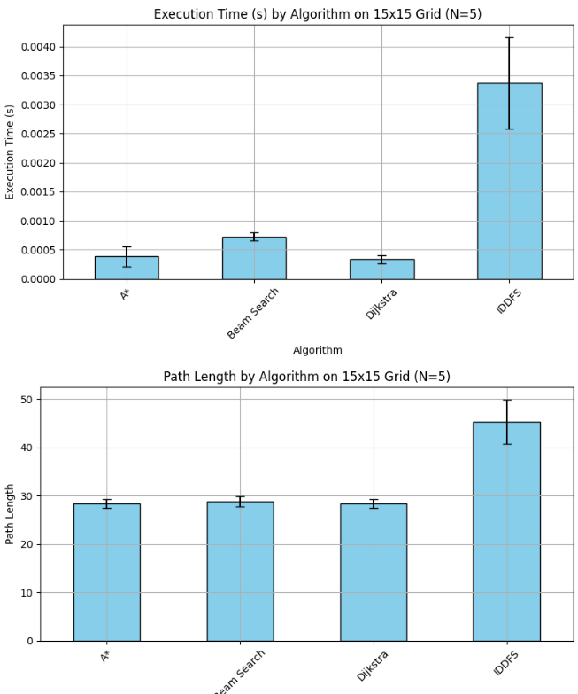
EXECUTION TIME & PATH LENGTH (15x15)
Mean execution time across 5 runs on 15x15 grid.
Error bars show standard deviation; Beam Search and IDDFS had the highest variability.
Hill Climbing failed in some runs and is excluded where no valid path was found.
Average number of steps taken by each algorithm to reach the goal.
IDDFS had the longest paths; Hill Climbing often failed due to local minima.

Slide 9
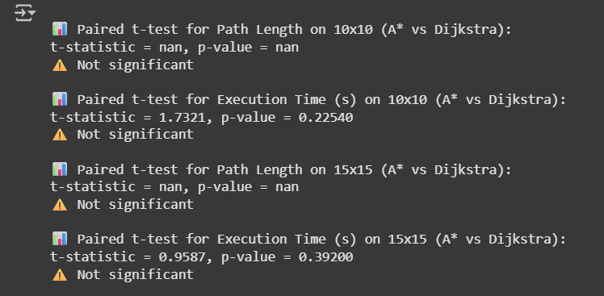
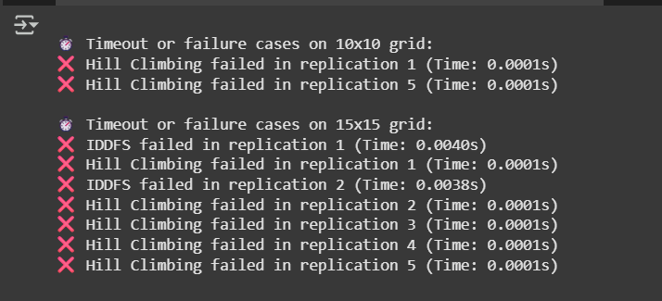
STATISTICAL TESTING
Paired t-tests were conducted to compare A and Dijkstra.*
Both algorithms are optimal and typically return the same path length.
Execution times showed minor variation, but differences were not statistically significant.
Tests performed on both 10x10 and 15x15 grids with N=5 runs.
p-values > 0.05 → Fail to reject H₀ (no significant difference).

Slide 10
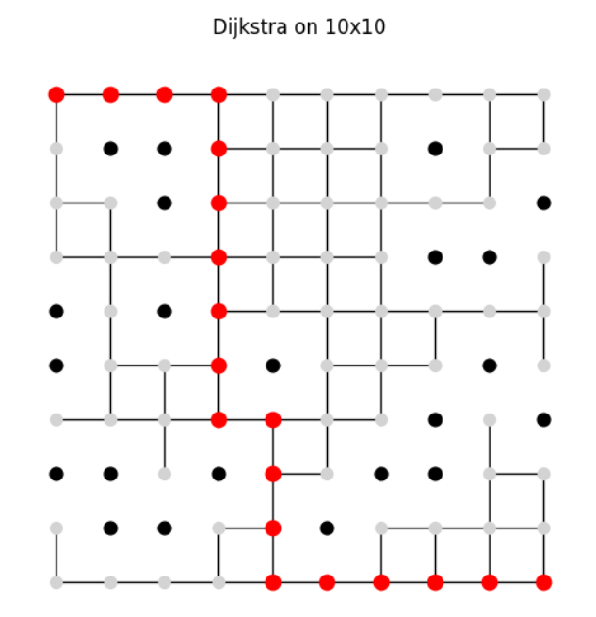
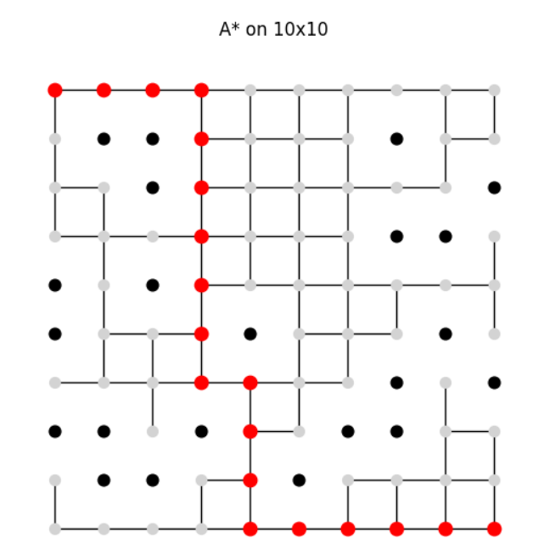
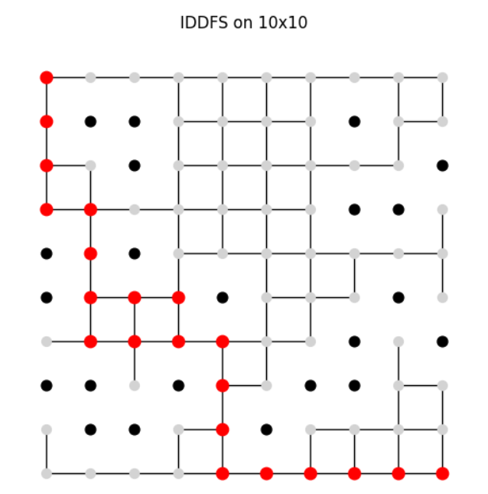
BEFORE vs AFTER PATHFINDING RESULTS (10x10)

Slide 11
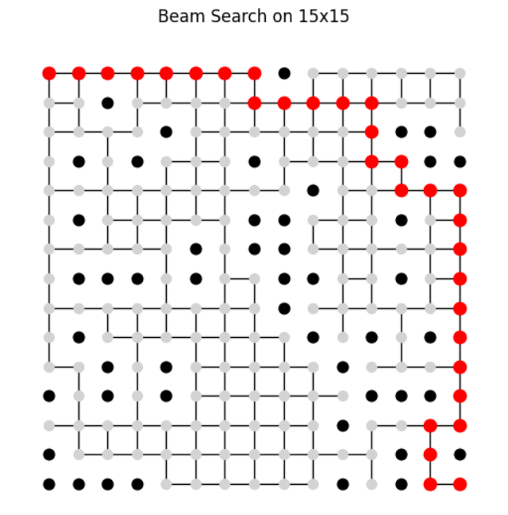
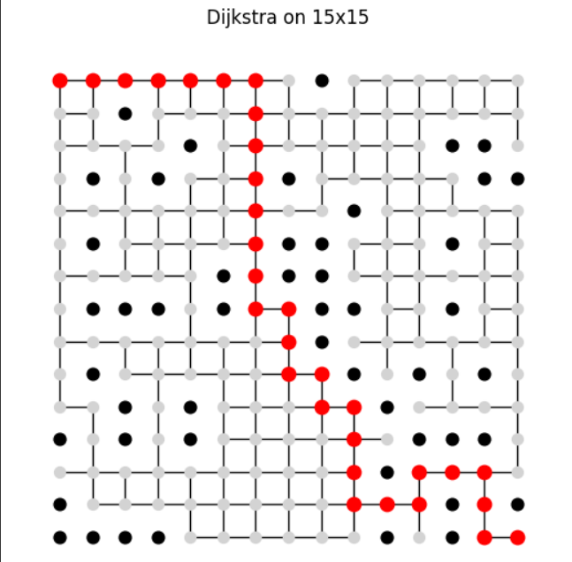
BEFORE vs AFTER PATHFINDING RESULTS (15x15)

Slide 12
OBSERVATIONS
A* Most consistent performer; excels in both speed and path quality.
Dijkstra Reliable and accurate, but slower due to no heuristic.
Beam Search Faster than exhaustive methods but sometimes sacrifices path quality.
IDDFS Completeness ensured but suffers from redundant exploration and long runtimes.
Hill Climbing Fast but often fails in complex mazes due to local minima.

